Slide 1

Vulnerability Tracking and Remediation System
SOA Project Review-2
Date& Time
 | Under the Guidance of Venkateswari Ketineni Assistant Professor, Department of Computer Science and Engineering, KLH CSE Bowrampet Campus
Team Members M Pranith Reddy – 2420030158 V Praneeth – 2420030636 Y Karthikeya - 2420030351

Slide 2

Outline of Project Work
Focus
Introduction
Literature Survey
Challenges
Research Objectives
Conclusion & Future Work
References
Publications Details

Slide 3
Problem Statement
Organizations face significant challenges in identifying, tracking, prioritizing, and resolving security vulnerabilities because these activities are often managed through fragmented and manual workflows. Security analysts may detect and report vulnerabilities, while developers are responsible for fixing them, but the absence of a unified platform creates communication gaps and delays in the remediation process. In addition, vulnerabilities may not be properly classified according to their severity, making it difficult to identify which security issues require immediate attention. Without automated lifecycle tracking, organizations may also lose visibility into whether a vulnerability has been reported, assigned, addressed, verified, or closed. The lack of timely notifications for new assignments, status changes, and approaching remediation deadlines can further increase the risk of critical vulnerabilities being overlooked. Therefore, there is a need for a centralized Vulnerability Tracking and Remediation System that brings these activities together, provides clear visibility into vulnerability status and severity, improves communication between security analysts and developers, and helps organizations reduce remediation delays and overall security exposure.

Slide 4
Objectives
Role-Based Access Control: Implement secure role-based access control (RBAC) for Administrators, Security Analysts, and Developers, ensuring that each role has appropriate permissions and responsibilities.
Vulnerability Lifecycle Management: Maintain the complete lifecycle of vulnerabilities, including reporting, assigning, remediation, verification, and closure, so that every vulnerability can be tracked from identification to resolution.
Vulnerability Prioritization: Classify vulnerabilities based on their severity levels and provide clear visibility into critical and high-priority security issues.
Automated Notifications: Generate automated email notifications and alerts for new vulnerability assignments, status changes, and approaching remediation deadlines.
Visual Analytics and Dashboard: Provide a centralized dashboard showing the status of open, critical, resolved, and closed vulnerabilities, along with reports and visual analytics for better decision-making.
Audit and Activity Tracking: Maintain audit logs of important user and system activities to provide accountability and traceability throughout the vulnerability management process.
Microservices-Based Architecture: Develop the system using independent microservices for authentication, user management, vulnerability tracking, remediation, notification, and auditing to improve modularity, scalability, and maintainability.

Slide 5
Literature Survey
Authors | Title of the Paper | Methodology | Inferences | Limitation/Future work
Hilal et. al. [3] | Intelligent Epileptic Seizure Detection and Classification Model Using Optimal Deep Canonical Sparse Autoencoder, Biology, 2022-mdpi | Coyote optimization algorithm (COA) for feature selection Krill herd algorithm (KHA) for parameter tuning | intelligent deep canonical sparse autoencoder-based epileptic seizure detection and classification model using EEG signals. It achieves a maximum accuracy of 98.67% and 98.73% under binary and multi-classification, respectively. | The paper does not mention the specific limitations of the proposed DCSAE-ESDC technique or the experimental analysis conducted using the benchmark epileptic seizure dataset
Smith et al. | 2023, IEEE Cloud | Used CVSS scoring along with cloud-native API integration for asset discovery and automated ticket generation. | Automated ticket generation achieved a reported 40% reduction in Mean Time to Remediate (MTTR). | Does not provide dynamic risk prioritization using real-time external threat-intelligence feeds.
Johnson & Lee | 2022, ACM Security | Applied Random Forest classification to predict the likelihood of vulnerability exploitation. | Categorized vulnerabilities into Critical, High, Medium, and Low, achieving about 92% prediction accuracy. | Requires large and continuously updated datasets to remain accurate against emerging and zero-day threats.

Slide 6
Problem Gap Identification
Traditional vulnerability tracking systems are often developed as large monolithic applications, which can become difficult to maintain and scale as the number of security events increases. Updating or modifying individual modules such as authentication, notifications, or vulnerability management can also affect the overall system. Another major gap is the lack of a modular vulnerability management platform that can efficiently connect authentication, user management, vulnerability tracking, remediation, and auditing. To address these limitations, the proposed system uses a microservices-based architecture, where each major function is developed as an independent service with REST API communication. This approach improves scalability, maintainability, modularity, and flexibility, while also reducing data coupling between services.

Slide 7
Innovation, Creativity, and Novelty
The proposed Vulnerability Tracking and Remediation System introduces a modular and scalable approach by using a microservices-based architecture instead of a traditional monolithic design. The system separates authentication, user management, vulnerability tracking, remediation, notification, and auditing into independent services, each with its own database. It uses Spring Cloud Gateway and Eureka for API routing and dynamic service discovery, while RabbitMQ enables asynchronous communication for notifications and audit activities. This combination provides better scalability, maintainability, and system resilience. The system also combines role-based access control, complete vulnerability lifecycle management, automated notifications, audit logging, and visual analytics in a single platform, providing security analysts, developers, and administrators with a unified environment for managing vulnerabilities efficiently.

Slide 8
Datasets Used
Project Component | Dataset / Tool | Purpose
Vulnerability Detection | Devign | Learn to identify vulnerable and non-vulnerable code
Vulnerability + Patch Relationship | CVEFixes | Connect vulnerable code with its fixed version
CWE Classification | CVEFixes | Identify and categorize vulnerability types
Severity | NVD/CVE Metadata | Provide CVSS-based vulnerability severity
Real-Time Scanning | Semgrep | Automatically scan uploaded source code for vulnerabilities
AI Remediation | CVEFixes + LLM | Learn remediation patterns and generate suggested fixes

Slide 9
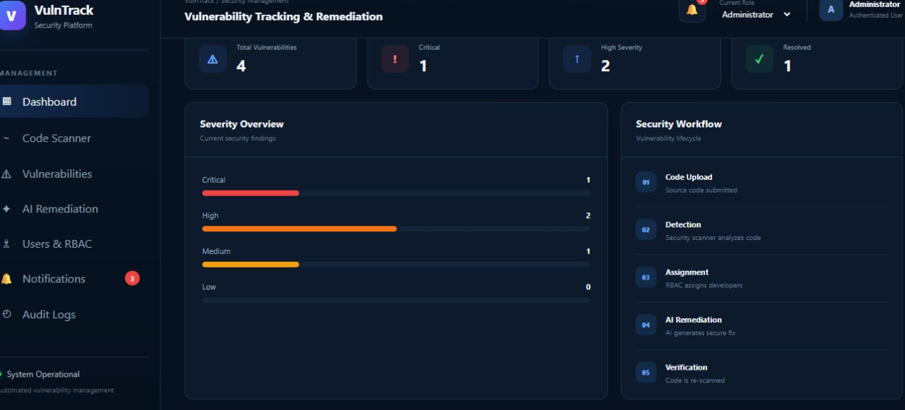
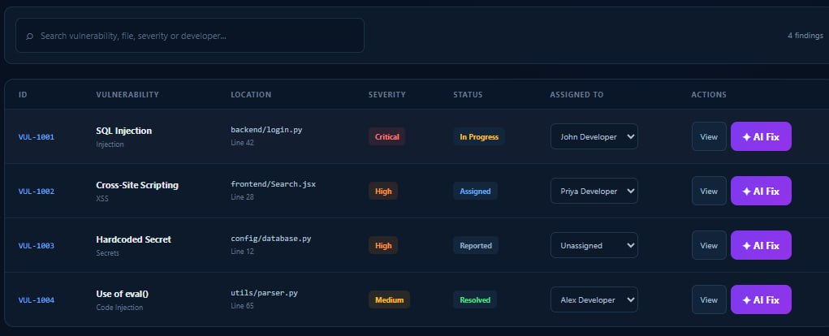
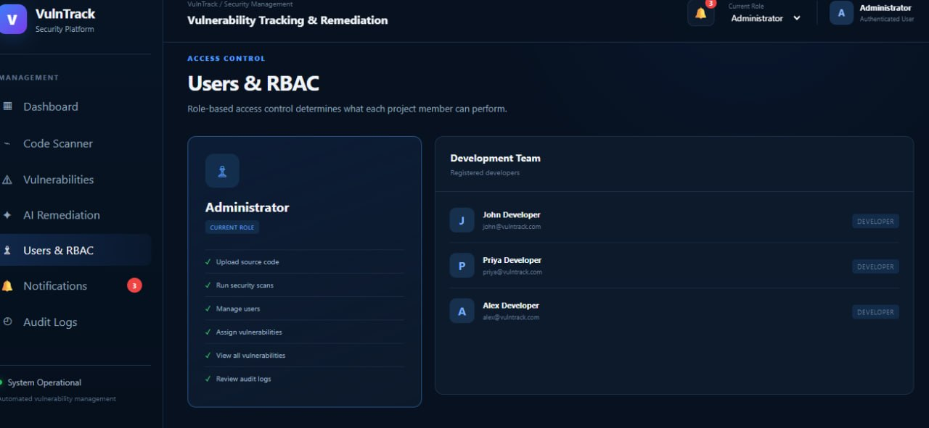
Implementation

